Slide 1


Health Care Monitoring System
M.M.M.Amry KAHDSE241F-023
A.Dhanushanandan KAHDSE241F-028
M.A.M.Ammar KAHDSE241F-025
M.Z.F.Zeena KAHDSE241F-022
Supervisor : Mr. Thisara

Slide 2

PROBLEM
STATEMENT
Paralyzed patients faces significant challenges due to their inability to communicate and the need in continuous monitoring of the vital signs. In Current healthcare monitoring system they do not have a real-time monitoring alert system which can help in emergency situations.
As an example, it is estimated that over 5 million people globally suffer from conditions like paralysis or restricted mobility. Additionally, the studies shows that the delays in emergency response due to insufficient monitoring systems can significantly increase the risk of mortality in vulnerable patients.

Slide 3
OBJECTIVES
Continuous of monitoring of vital signs
Emergency Alerts and Notifications
Fall detection alert
Real-time Data accessibility
Audio Alert System
User-Friendly interface
The project utilizes an Arduino-based system with multiple healthcare sensors for real-time data collection, processing, and emergency response, enhancing safety through fall detection and live location tracking.

Slide 4
SOLUTION OVERVIEW
The IoT-based Advanced Health Care Monitoring System offers real-time monitoring and emergency response for paralyzed patients, tracking vital health parameters via an Arduino-based microcontroller and displayed on an OLED screen and mobile application.
1. Real-Time Data Monitoring and Alerts
continuous tracking of patient health metrices with immediate notifications
SMS alerts with GPS location sent to guardians and medical teams
2. Fall Detection System
incorporates a fall detection sensor to identify and alert incase there is a fall
3. Integrated Voice Alert System
Includes an audio notification system for local alerts providing a direct and immediate signal
4. Mobile App Integration
Allows remote access to real-time health data through a user-friendly mobile application
5. Versatile Hardware Modules
Uses GPS for live location tracking and GSM modules for SMS alerts

Slide 5

PROJECT SCOPE AND LIMITATIONS
Scope
The Advanced Health Care Monitoring System is designed to provide a reliable and efficient solution for continuous health monitoring and emergency management for paralyzed patients.
1. Features and Coverage
continuous real-time monitoring of vital signs
integration with an OLED display
remote data access via a mobile app
automatic SMS alerts and live GPS location
fall detection with alerts to guardians
audio notifications for immediate alerts
2. User Interaction
3. Future Scalability

Slide 6
Project Limitations
Hardware Dependency: Sensor accuracy can be affected by environmental factors like humidity and temperature
Connectivity Requirements: SMS alerts and Live location sharing depend on a strong WIFI or GSM network
Energy Efficiency: System's continuous operation requires a reliable power source
Data Security: Although mobile app provide security features data still may be vulnerable to cyber threats
Assumptions
The patient enjoys stable internet connectivity and GSM signal strength, and the Blynk app is accessible to caregivers and medical staff via compatible mobile devices.

Slide 7

SYSTEM ARCHITECTURE
The Advanced Health Care Monitoring System follows a modular architecture, integrating hardware components for data collection, processing, and communication. The architecture ensures real-time monitoring and effective emergency management through IoT technology.
Sensors (Data Collection):
Heart Rate Sensor (MAX30105
Temperature Sensor (DS18B20
ECG Sensor (AD8232
Fall Detection Sensor (MPU6050)
Microcontroller (Data Processing):
Arduino Mega
Display System (Data Visualization):
OLED Display
Alert System:
Audio Alert (DF Player Module + Speaker
Communication Modules (Data Transmission):
Wi-Fi Module (ESP8266
GSM Module (SIM800L)
GPS Module (NEO6MV2)
Mobile App:
Blynk App or FireBase.

Slide 8
Data flow and Interactions
Data Collection:
Sensors collect vital health data (heart rate, temperature, blood pressure, ECG,SpO2 level, and fall detection)
Data Processing:
The Arduino Mega processes sensor data, identifies abnormalities, and determines if an alert needs to be triggered
Data Transmission:
SMS Alerts: Sent to guardians and hospital staff using the GSM module.
Live Location: Shared using the GPS module to locate the patient.
Audio Alerts: Triggered locally through the DF player module and speaker.
Remote Data Access:
The ESP8266 module sends real-time health data to the Blynk app via Wi-Fi, allowing remote monitoring.
Local Data Visualization:
The OLED display shows real-time health information for caregivers near the patient.

Slide 9
HARDWARE AND SOFTWARE COMPONENTS
Hardware
Software
Arduino Mega
Esp8266
GSM Module (SIM800L)
OLED Display
Heart rate sensor (MAX30105)
Temperature sensor (DS18B20)
Blood Pressure sensor (MAX30105)
Fall detection sensor (MPU6050)
ECG sensor (AD8232)
DF player module and speaker
GPS module (NEO6MV2)
Arduino IDE
BLYNK App

Slide 10
LITERATURE REVIEW
Data Collection
The Advanced Health Care Monitoring System collects data through various sensors integrated into the hardware setup
Vital Signs Monitoring Sensors ( Heart Rate Sensor,Temperature Sensor, Blood Pressure Sensor, ECG Sensor)
Fall Detection ( Fall Detection Sensor )
Communication Modules for Alerts ( GSM and GPS modules )
Data Storage
Data is displayed in real-time but not permanently stored within the system. For continuous monitoring:
Blynk App: Serves as a temporary storage platform where caregivers can view patient health records.

Slide 11
Data Processing
Real-Time Data Integration (Sensor readings are continuously collected and interpreted by the Arduino Mega microcontroller, And the system uses pre-defined thresholds to identify emergencies too)
Signal Processing ( The ECG sensor’s analog signals are filtered and amplified to produce readable outputs )
Data Communication (The ESP8266 Wi-Fi module transmits data to the Blynk app for real-time monitoring And the GSM module sends SMS alerts to designated contacts, and the GPS module provides live location.
Data Analysis Methods
Threshold-Based Alerts
Pattern Recognition
Emergency Algorithms

Slide 12
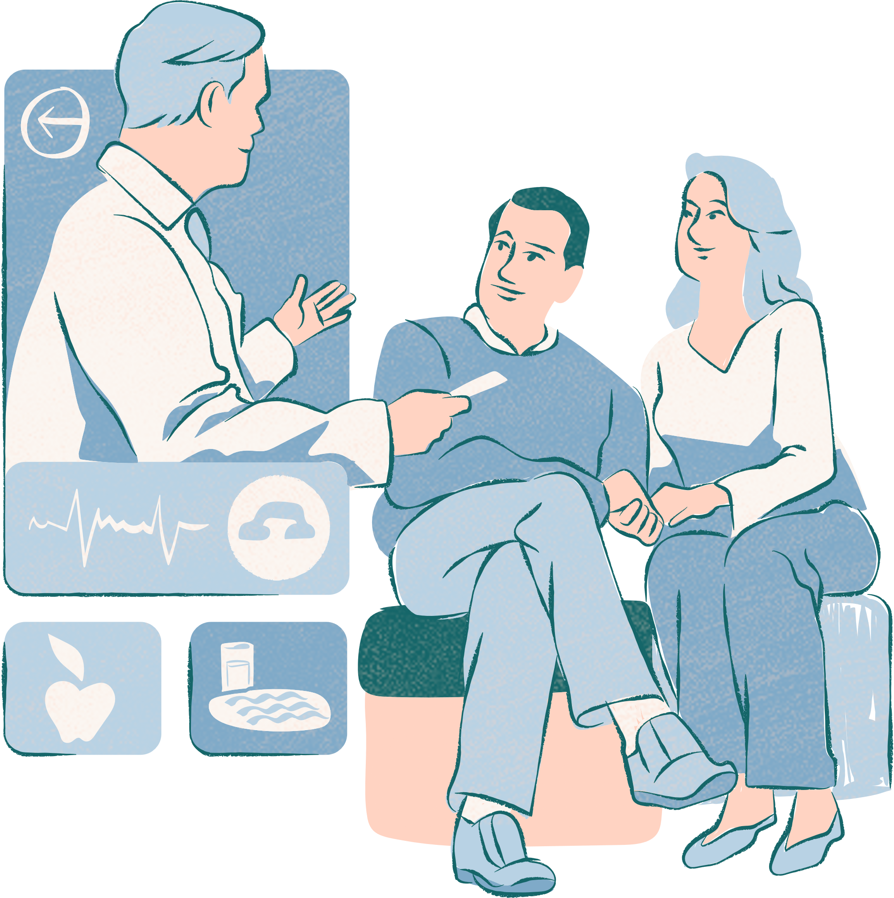
NETWORK AND SECURITY CONSIDERATIONS
Network Structure
Wi-Fi Connectivity
GSM Communication
GPS Module
Local Display
Data Secutiry Measures
Secure Data Transmission
Access Control
Data Privacy
Network Reliability

Slide 13

EXPECTED BENIFITS
Improved patient safety and Health Monitoring
Enhanced Caregiver Efficiency
Timely Emergency response
Cost savings for patients and caregivers
Hospital Efficiency
Improved quality life for patients
Support for families and caregivers
Accessibility and inclusion

Slide 14
TIME LINE
WEEK 1
Research and find the suitable components for the project and discuss about the project.
WEEK 2
Finalize the circuit diagrams and hardware connections.
WEEK 3 &4
Develop the code for the project.
WEEK 5
Test the code and components finalize the project.

Slide 15
CONCLUSION
The Advanced Health Care Monitoring System uses IoT technology and real-time sensors to monitor paralyzed patient’s health, providing early detection of issues and emergency alerts. It improves patient’s safety, independance, and eases the burden on caregivers. Features like fall detection and live location sharing enhance reliability. While it has limitations, such as network dependance and sensor accuracy, The system offers significant potential for future improvements and scalabilty in healthcare

Slide 16
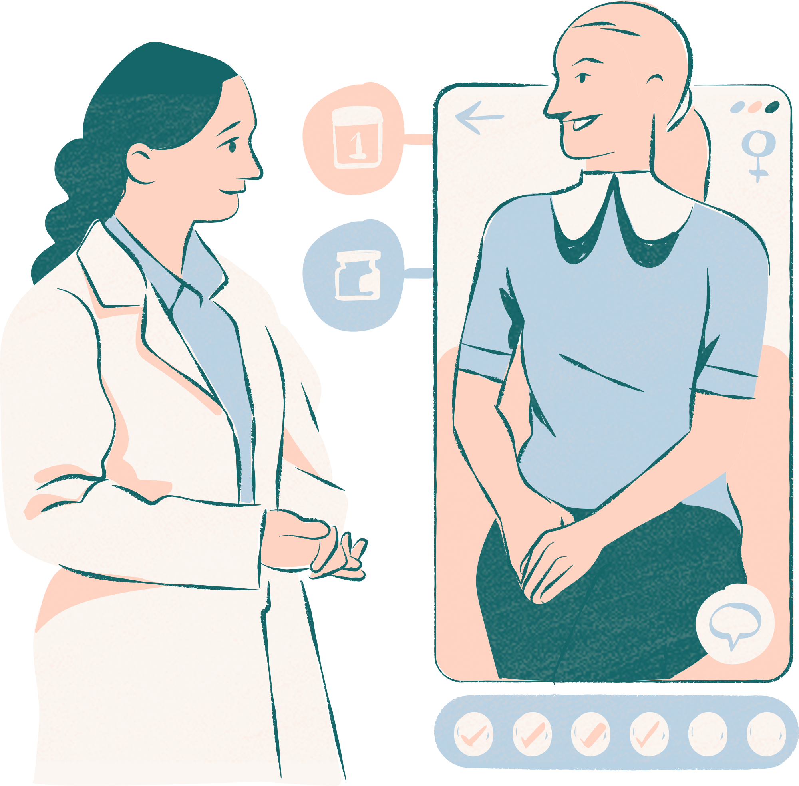
Thank you very much!

